Slide 1


Embedded Systems Workshop
Session
4

Slide 2



Hello!
Instructor: Mariam Ahmed.
Cairo University, EECE Department.

Slide 3


Slide 4


Content
MCAL vs HAL vs APP
GPIO Registers
Input vs Output
Pull-up vs Pull-down

Slide 5

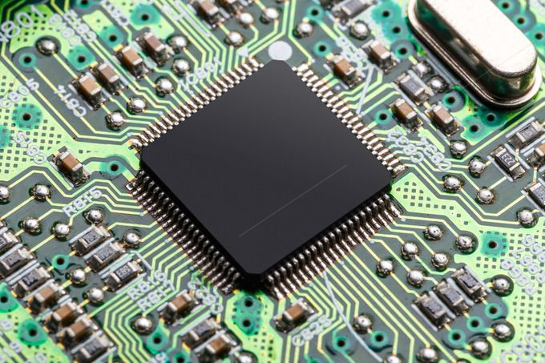
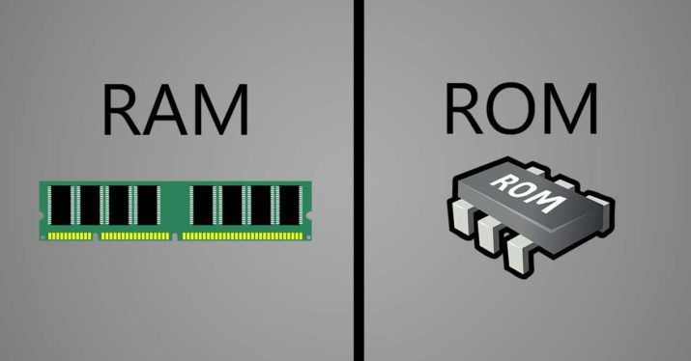
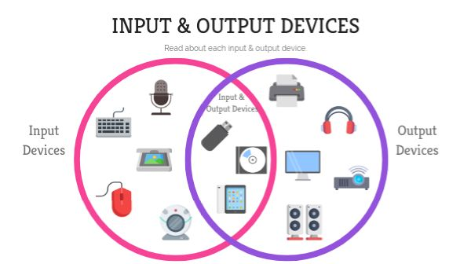

REMEMBER
Any computing system contains:
CPU
Memory
I/O Peripherals
Notes:
Know why the difference in shape between the ram and the rom (just in case someone asked)
Know how to zoom in so that ur able to show the I/O peripherals clearly

Slide 6
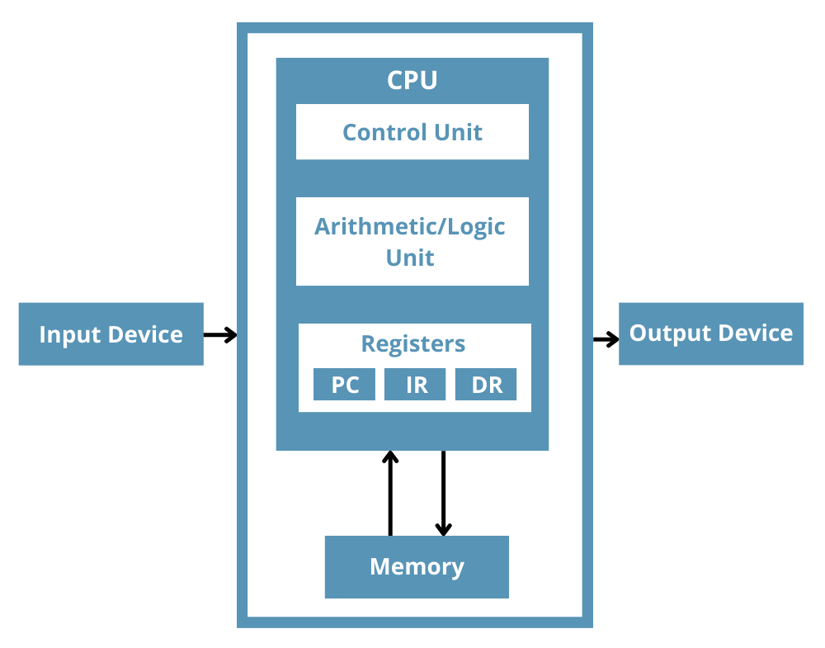
REMEMBER
Registers:
Registers are small, fast storage locations inside the CPU.
Used to store (Temporary data, Control information, Results of operations).

Slide 7
Peripherals
There are two types of registers:
On-chip peripherals
Off-chip peripherals
Timers
Motors
ADC
GPIO
LCD
Communication interfaces
Sensors
Camera

Slide 8

Peripherals
On-chip
Off-chip
GPIO → buttons & LEDs
Timers → motor control
Communication → camera
Motors
Camera
Sensors
Drone Behaviour
Take-off / landing
Stabilization
Camera control
Notes:
Ask:
Where do we write the code?
What happens if hardware changes?
What if we reuse the project?

Slide 9
Why Layered Architecture?

Slide 10
Layered Architecture
What is Layered Architecture?
APP
Layered architecture is a software design approach that organizes an embedded system into multiple layers.
Each layer has a specific responsibility and interacts only with specific layers.
HAL
MCAL

Slide 11
Layered Architecture
Why Layered Architecture?
APP
Separation and abstraction.
Easier debugging and testing.
Code reusability
Hardware independence
HAL
MCAL

Slide 12
MCAL vs HAL vs APP

Slide 13
MCAL vs HAL vs APP
APP
Application Layer
HAL
Hardware Abstraction Layer
MCAL
Microcontroller Abstraction Layer

Slide 14
MCAL vs HAL vs APP
APP
Defines the overall system behaviour and application.
HAL
Provides drivers and modules for interfacing with off-chip peripherals.
MCAL
Provides drivers and modules for interfacing with on-chip microcontroller peripherals.

Slide 15
MCAL
HAL
GPIO
Timers
Motors
Camera
Communication
Sensors
APP
Take-off/Landing
Stabilization
Camera Control

Slide 16
LIB Layer
LIB: Library layer
LIB
APP
Provides common utility functions and definitions that can be used by all software layers.
It includes Common macros and definitions:
Bit manipulation utilities.
Standard data types.
Bit manipulation → BIT_MATH.h
Standard data types → STD_TYPES.h
HAL
MCAL

Slide 17
GPIO Registers

Slide 18
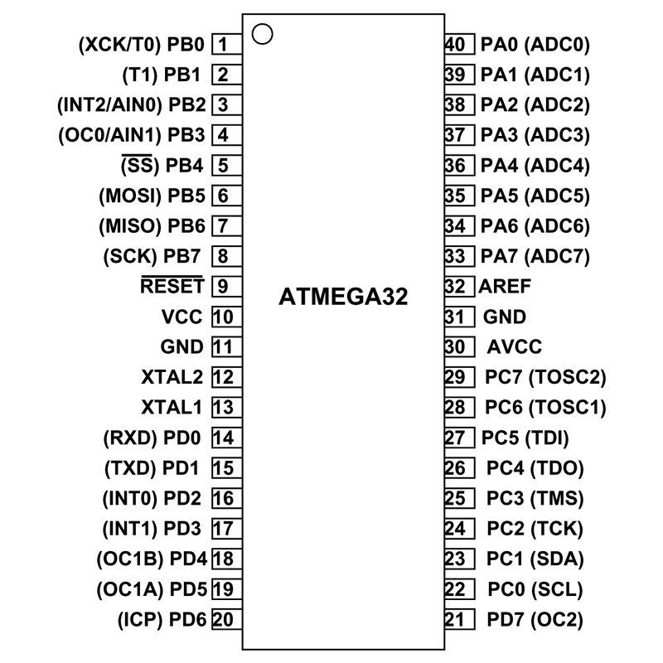
ATmega32 Pin overview
There are two types of pins:
Specific purpose pins
VCC
GND (2 Pins)
AVCC
AREF
XTAL1
XTAL2

Slide 19
ATmega32 Pin overview
There are two types of pins:
Specific purpose pins
General purpose pins (GPIO/DIO)
VCC
GND (2 Pins)
AVCC
AREF
XTAL1
XTAL2
PORT A
PORT B
PORT C
PORT D

Slide 20
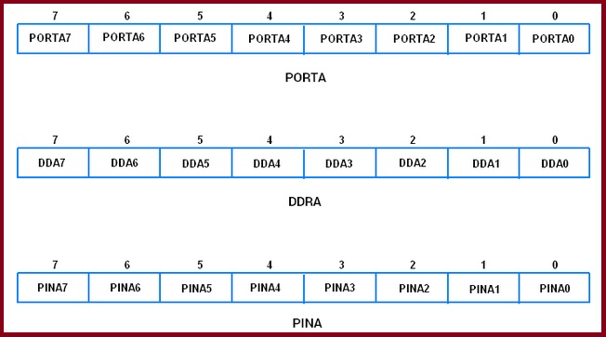
GPIO Registers
Each PORT has 3 registers:
DDR: data direction register
PORT: output data register.
PIN: input data register.
So, for each port these 3 registers for example:
Port A: A0→A7, DDRA, PORTA, PINA

Slide 21
How Do Layers Appear In Code?

Slide 22
Code Organization Based on Layered Architecture
APP
main.c
HAL
led.c / button.c
MCAL
GPIO.c
LIB
bitmath.h / standard_types.h

Slide 23
LIB Layer

Slide 24
LIB Layer in Code
Compiler x
Compiler y
Memory explosion
int x;
// int → 2 bytes
int x;
// int → 4 bytes
Data loss

Slide 25

LIB Layer in Code
To solve this problem, use specific data types like:
Signed long int
Unsigned short int
Not practical
To make it more practical and easier to deal with:
Signed char → s8
Unsigned short int → u16
Unsigned long int → u32
How to achieve so in C?
Using typedef

Slide 26
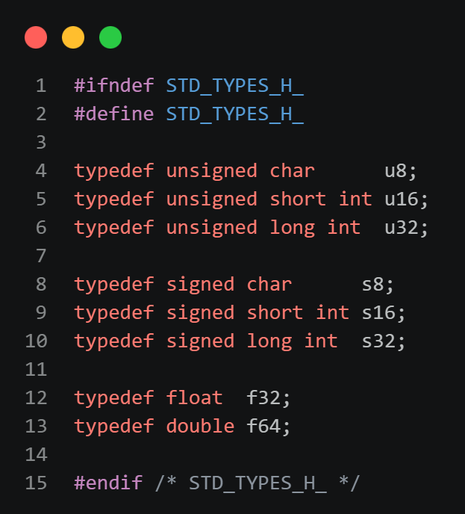
LIB Layer in Code
STD_TYPES.h file:
STD_TYPES.h is a library file that defines fixed-size, compiler-independent data types to ensure consistent memory usage across different compilers
STD_TYPES.h is located in the LIB layer.
typedef data_type new_data_name

Slide 27
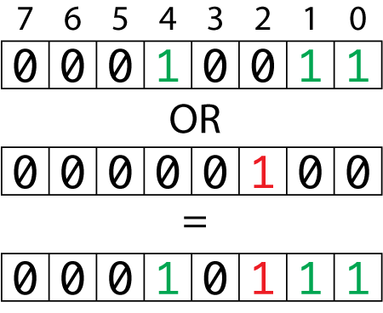
LIB Layer in Code
Bit Manipulation:
Set bit
Clear bit
Toggle bit
Get bit
Rotate bit left/right
Set bit number 2
Why?
Registers are controlled using bits
Bit operations are used in all layers
Rewriting bit logic reduces readability and safety

Slide 28
LIB Layer in Code
Bit Manipulation using bitwise operators:
Set bit:
REG |= (1<<BIT)
Clear bit:
REG &= (~(1<<BIT))
Toggle bit:
REG ^= (1<<BIT)
Get bit:
(REG & (1<<BIT)) >> BIT
Rotate left bit:
REG = (REG<<num) | (REG>>(8-num))

Slide 29
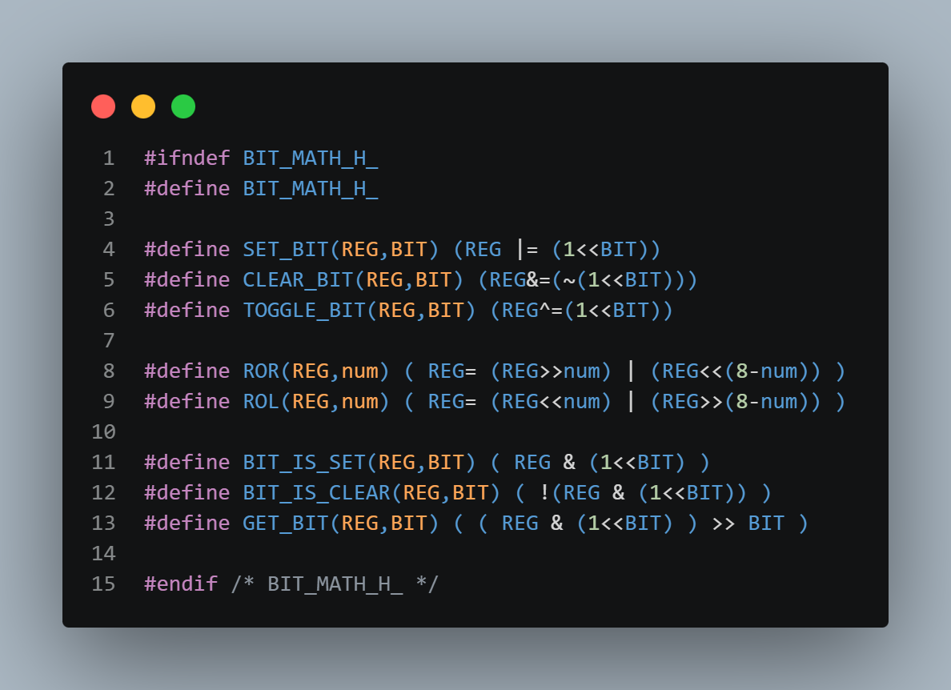
LIB Layer in Code
BIT_MATH.h file:
BIT_MATH.h is a library file that provides reusable macro functions for performing bit-level operations on registers in embedded systems.
BIT_MATH.h is located in the LIB layer.

Slide 30
MCAL Layer

Slide 31
MCAL Layer in Code
To access any peripheral, we deal with its registers.
So, to access the GPIO we deal with the registers: DDR, PORT, PIN.
Register accessing using pointers:
To access registers, we access their addresses by using pointers:
u8 *DDRA = (u8*) 0x3A;
u8 *PORTA = (u8*) 0x3B;
Not practical

Slide 32
MCAL Layer in Code
Why not practical?
Memory consumable.
* DDRA is used to access the register instead of DDRA directly.
To solve this, use #define:
#define DDRA (*(volatile u8*)(0x39))
Why volatile?
volatile prevents the compiler from caching a variable, ensuring each access reads the current value from the hardware.

Slide 33
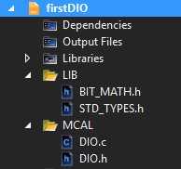
MCAL Layer in Code
GPIO Driver consists of two files:
GPIO.h file is a header file that contains function prototypes, macros, and configuration options for the GPIO driver.
GPIO.c file is a source file that contains the implementation of the functions declared in GPIO.h file.

Slide 34
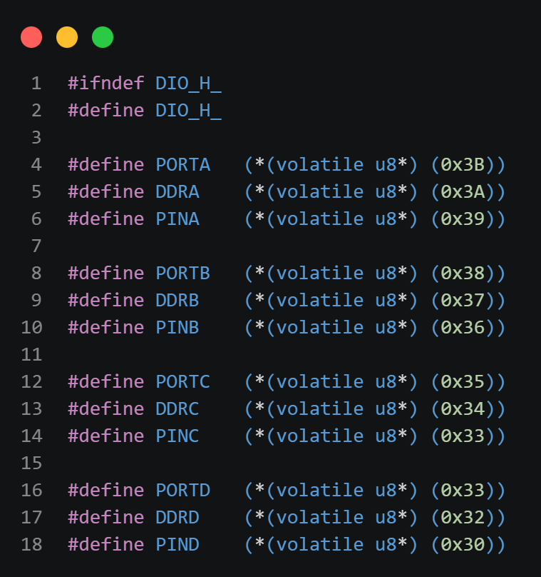
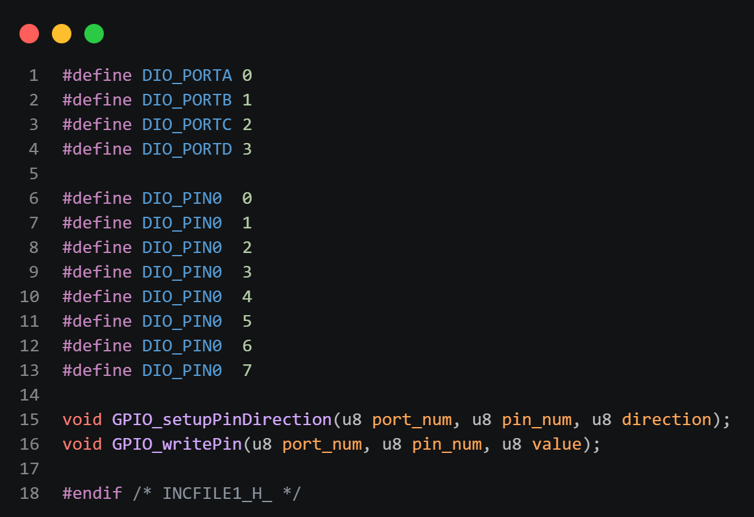
MCAL Layer in Code

Slide 35
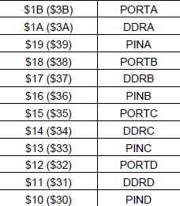


MCAL Layer in Code
For register addresses refer to Atmega 32 Datasheet, inserted table in page 327

Slide 36
GPIO Driver

Slide 37
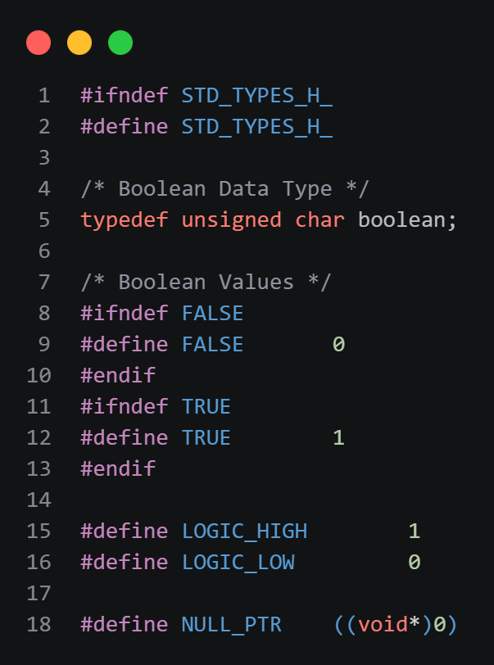
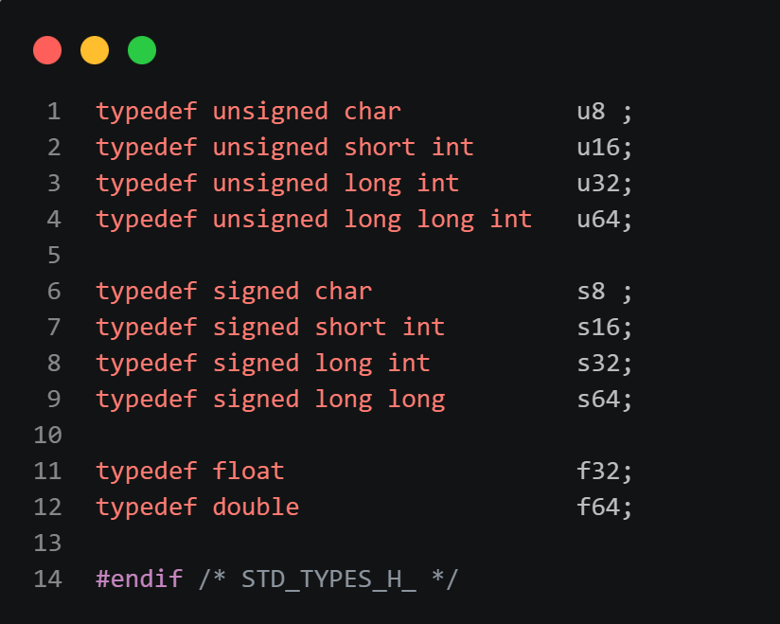
STD_TYPES.h

Slide 38
BIT_MATH.h

Slide 39
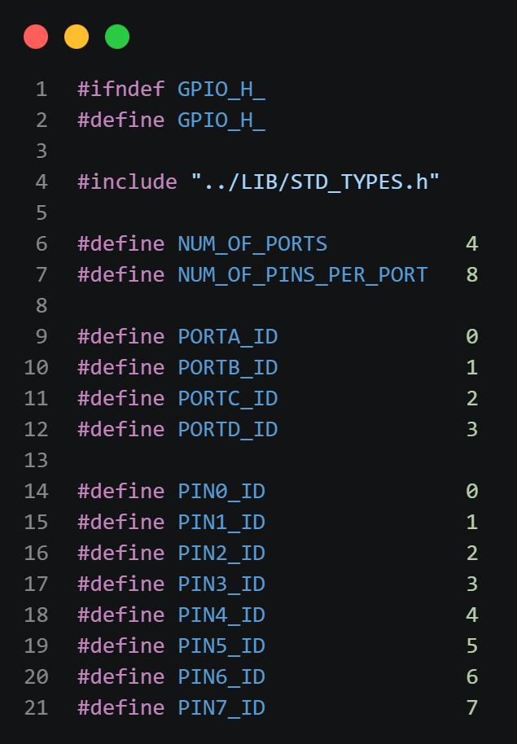
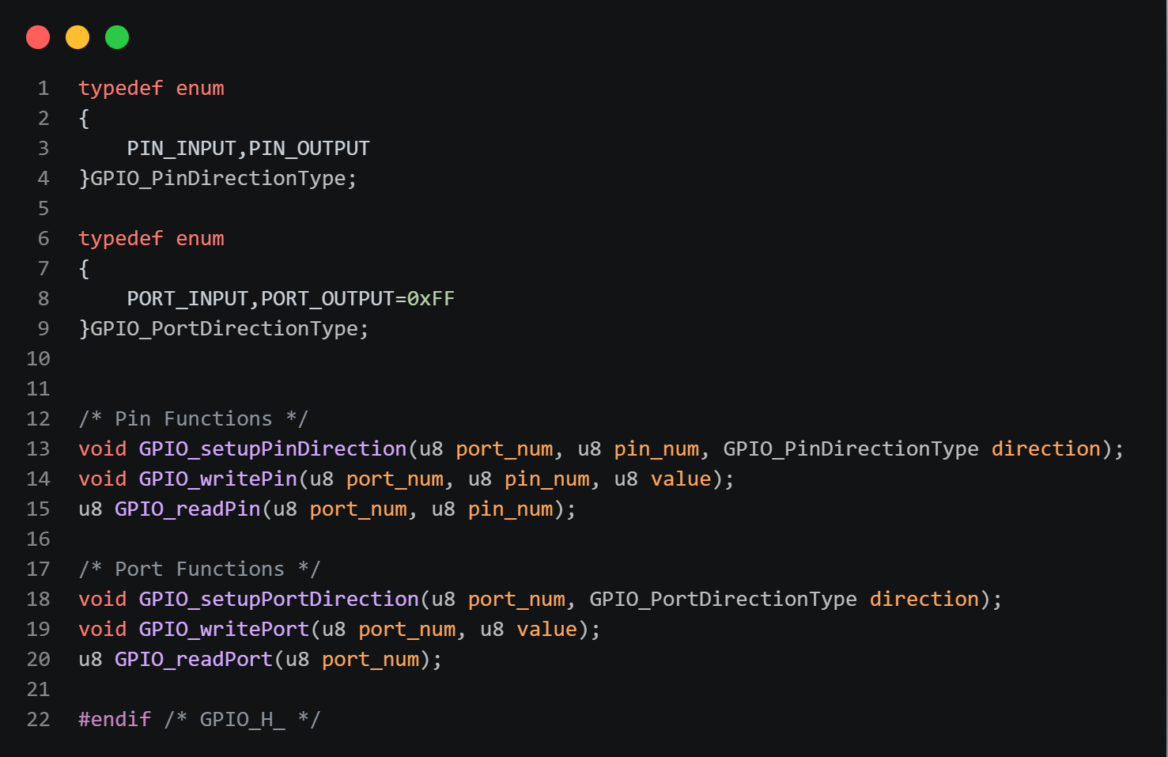
GPIO.h

Slide 40
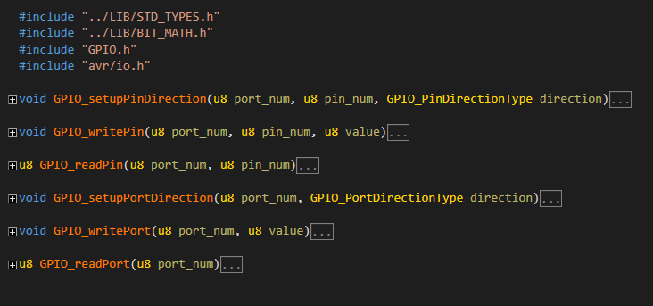
GPIO.c

Slide 41
Break

